Slide 1

Document Library
Presented By
Kartik Velede

Slide 2
Document Library
Document library is a place where an individual in an organization can store document securely and can be accessed by all the employees in the organization

Slide 3
Version History
Version history helps to restore previous versions of document and also keeps track of the previous so that reversal can be done when mistaken is done accidental.

Slide 4
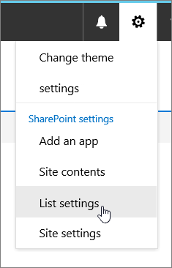
Configuring of Version History
Open the document library you want to configure version history
Go to settings and choose list settings

Slide 5
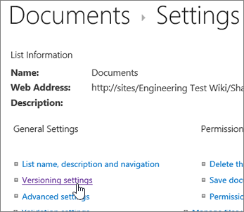
Step-2
On the setting page ,click on version settings

Slide 6
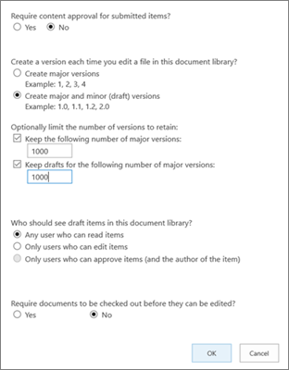
Step-3
From the versioning page choose the following as shown in the figure.
Select ok.

Slide 7
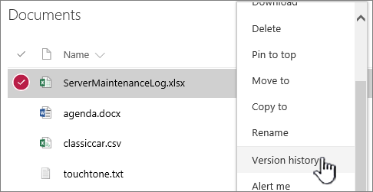
Restoring an earlier version.
Open the document you want to restore document.
Select version history

Slide 8
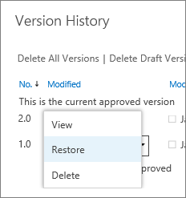
Step 2:
From the menu we can choose the following.

Slide 9

Thank you

